Slide 1

Geospatial Data

Slide 2
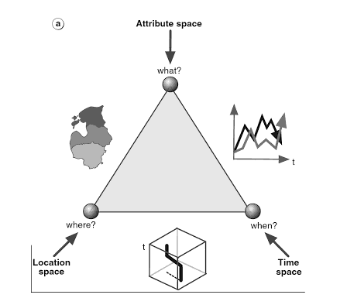
Kraak & Ormeling, 2010. Cartography, third edition, visualization of spatial data.
Notes:
Characteristics of geospatial data, the location, attribute and time – can think of as where, what when.

Slide 3
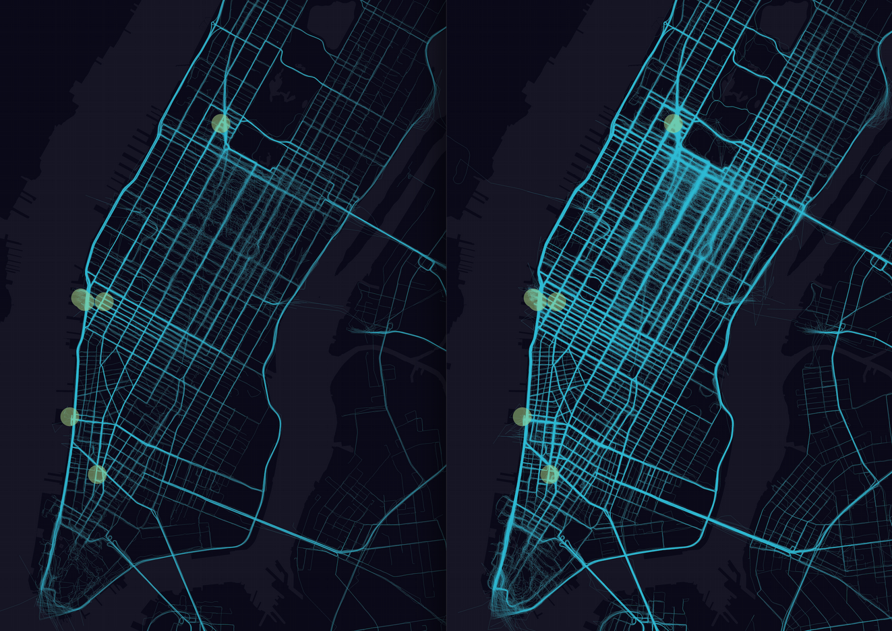
https://newsroom.uber.com/why-riding-pool-should-be-the-new-fashion-week-trend-2/
Notes:
Green dots indicate venues for nyc fashion week, and blue lines show uber pool trips originating and ending from those venues = location space, attribute space, missing time space

Slide 4
1 Week Before
NYC Fashion Week
Aug. 28 – Sept. 3
2014
During
NYC Fashion Week
Sept. 4 – 11
2014
https://newsroom.uber.com/why-riding-pool-should-be-the-new-fashion-week-trend-2/

Slide 5
Don’t Forget Measurement Scales
Categorical
Ordinal
Interval
Ratio
Notes:
Remember our previous data models

Slide 6
Discrete vs. Continuous
Discrete (categorical) data: objects bordered on all sides with explicit coordinates for boundary
Examples: buildings, rivers, roads, states, counties
Continuous data: not well defined boundaries, a concentration level or field
Examples: precipitation, topography, terrain, temperature, gravity field
Notes:
Type of data for the attributes that you’re mapping – ask, how easily can define boundaries?
Discrete – boundaries often nouns
Continous has such as precipitation or topography
Continuous may be converted to discrete

Slide 7
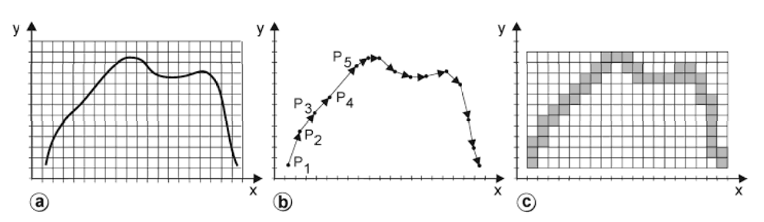
Vector vs. Raster
Representation of a line
in vector format
in raster format
Kraak & Ormeling, 2010. Cartography, third edition, visualization of spatial data.
Notes:
Ways of storing digital data
Vector data – uses points, lines, polygons; each vertex is stored as coordinates
Raster data – grid cells as pixels
Discuss more specific applications in GIS while this will come up again when we discuss optimization - graphics

Slide 8
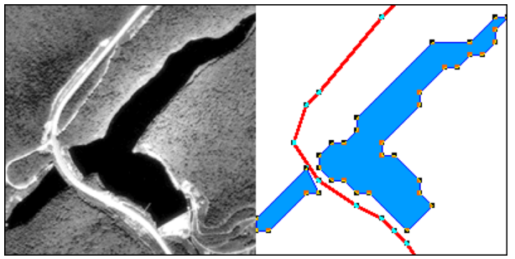
Vector vs. Raster
Objects as points, lines, and areas
Elements are discrete & homogenous
Smaller file sizes, high-spatial resolution
Source: https://www.e-education.psu.edu/geog486/l1_p8.html
Notes:
This should be familiar working with SVG in D3
Can be precise in defining, but can’t account for variation welll

Slide 9
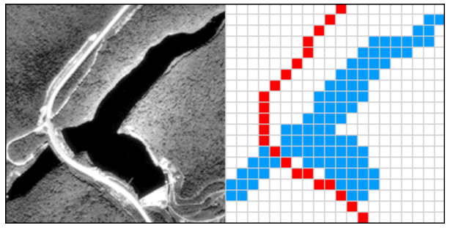
Vector vs. Raster
Grid / pixels to cover space
Each location has a value (even if 0)
Larger file sizes, resolution dependent
Source: https://www.e-education.psu.edu/geog486/l1_p8.html
Notes:
http://downloads.esri.com/support/whitepapers/ws_/AWSvector-raster-mapping_0307.pdf

Slide 10
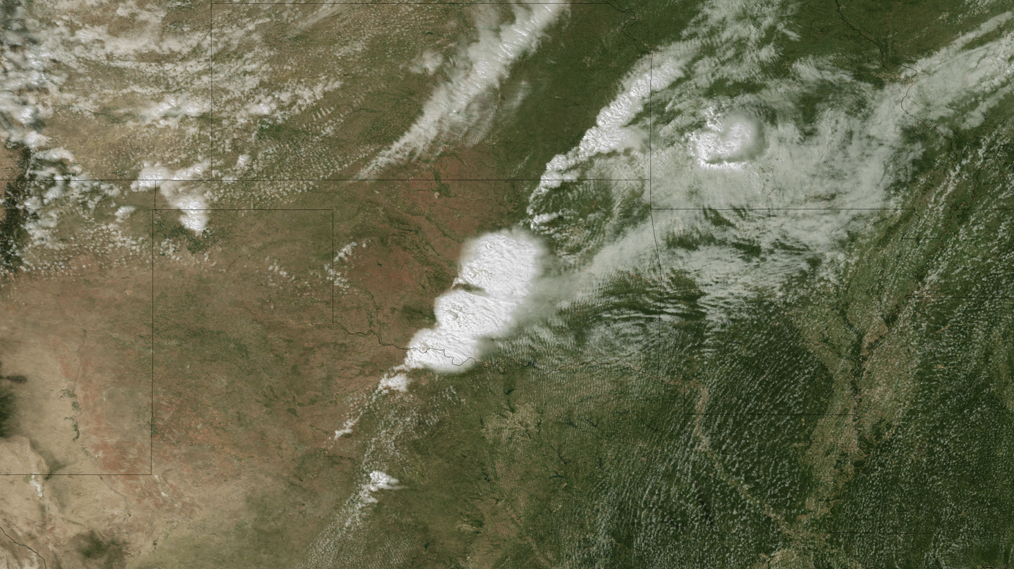
Vector vs. Raster
https://www.weather.gov/
Notes:
Raster is good for real life image such as Satellite Imagery or aerial photos, a lot of variation
Comes up again when we discuss optimization

Slide 11
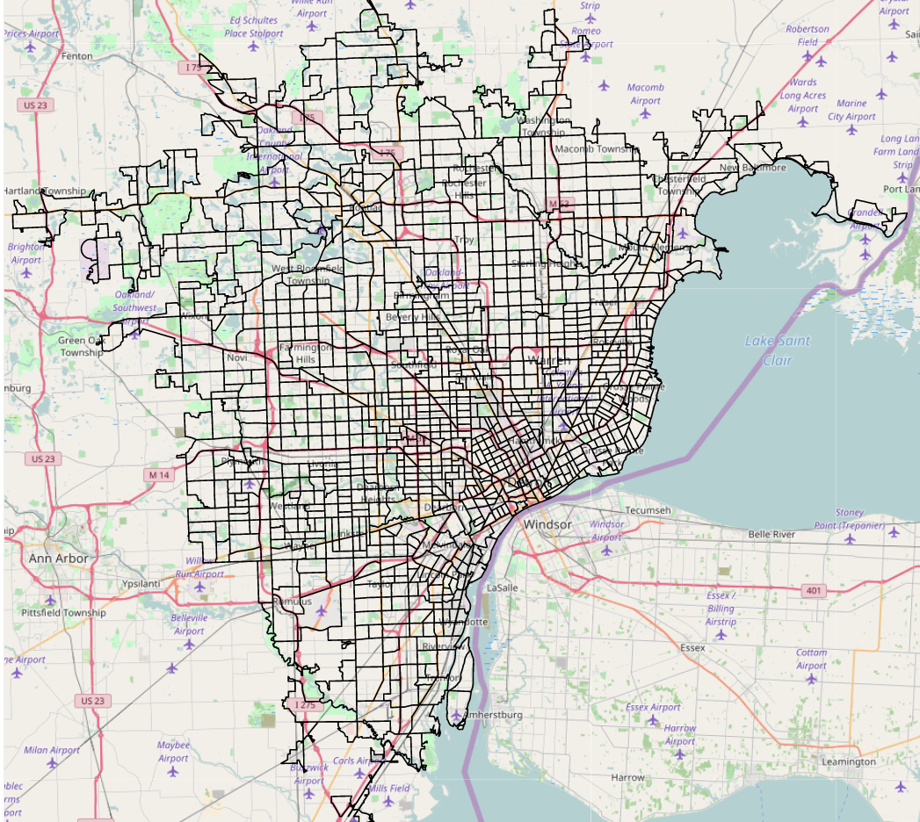
D3 Raster & Vector
http://bl.ocks.org/mbostock/94b9fd26e12c586f342d

Slide 12
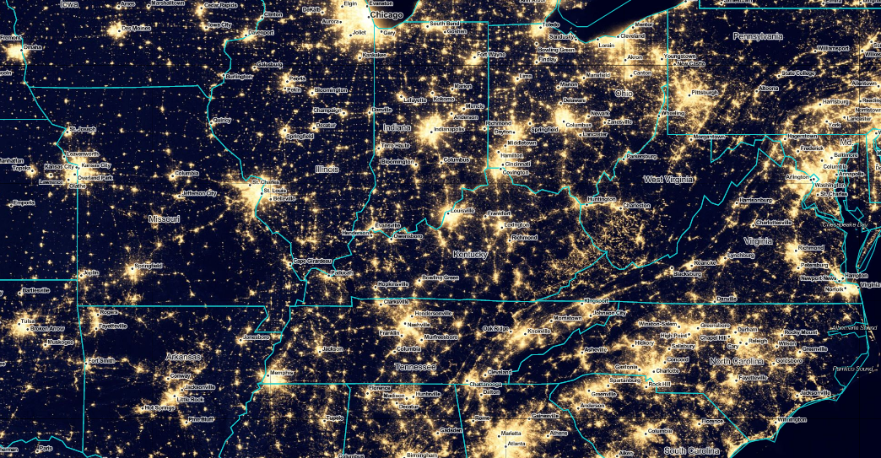
D3 Raster & Vector
http://bl.ocks.org/curran/96823ad84b0415536980b1cbf57b1dcc
Notes:
Raster earth at night
Vector - state borders
Raster – labels

Slide 13
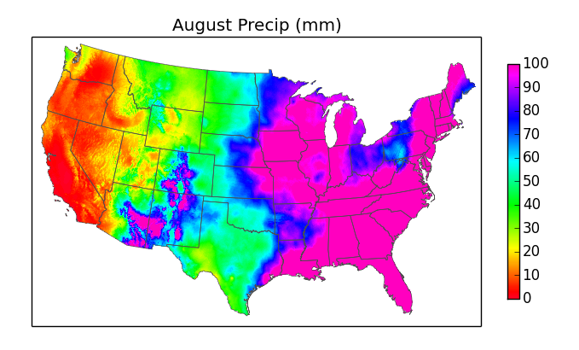
Matplotlib Raster & Vector
Image Source: https://waterprogramming.wordpress.com/2014/10/03/python-clip-raster-data-with-a-shapefile/
Using http://matplotlib.org/basemap/
Notes:
Uses basemap a toolkit for matplot lib to map raster data over boundried map here,

Slide 14
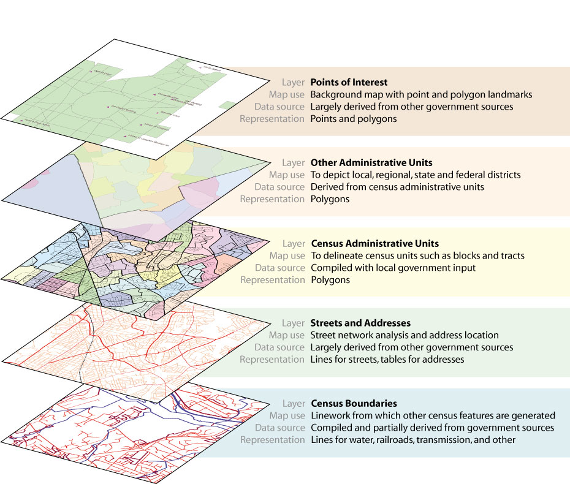
Map Layers of Detail
http://www.esri.com/news/arcnews/summer03articles/summer03gifs/p29p1-lg.jpg
Notes:
What attributes to include and to what level of detail?

Slide 15
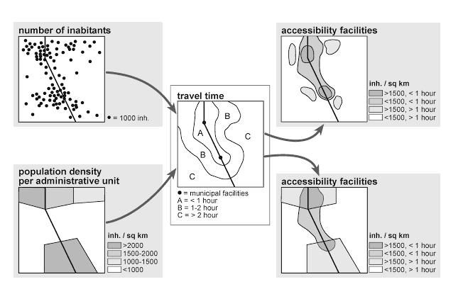
Aggregating Data
Kraak & Ormeling, 2010. Cartography, third edition, visualization of spatial data.
Notes:
Difference between original or aggregated data – explain
Where to put buildings?
Data processing and data quality matter!

Slide 16
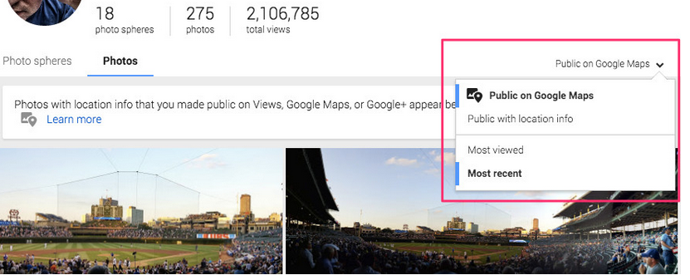
Public vs. Private
Source: http://www.androidcentral.com/your-public-google-images-might-now-show-google-maps
Notes:
Level of detail prublic private
Be working with making design decisions based on the particular data model

Slide 17


